Slide 1
ECONOMICS and COMPUTATION
Group 6

Slide 2
Definition
Computational economics is a field of economic study at the intersection of computer science, economics and management science. The main focus of is the integration of information (IT) into economics and the automation of formerly manual processes.
Notes:
integration of information (IT) into economics - Shows the information of the economic process
Computational Economics – from the word computation, it computes, uses computers to monitor the economic movement based on the real world in order to help us predict economic strategy specially in marketing. Also sees movement of individuals for opportunities.

Slide 3
Computational economics uses advanced computing to solve problems from all branches of economic study. Both empirical and theoretical economics can use computational economics.
Reference: https://whatis.techtarget.com/definition/computational-economics

Slide 4

HELLO!
Areas of study within the field of computational economics include:
Agent-based computational modelling.
Computational econometrics and statistics.
Computational finance. Computational modelling of dynamic macroeconomic systems.
Computational tools for the design of automated internet markets.
Programming tools for computational economics.

Slide 5
What are Algorithms in computational economics ?
Dynamic Programming
Agent-Based models
Dynamic stochastic general equilibrium models
Artificial Intelligence
Genetic Algorithms

Slide 6
What are tools in computational economics ?
MATLAB
R language
Python
Mathematica (propriety)
Maple (propriety)
Notes:
Matlab – Analyze data , develop algorithm, and create mathematical models
Mathematica - modern technical computing system spanning most areas of technical computing — including neural networks, machine learning, image processing, geometry, data science, visualizations, and others.
Maple provides an interactive problem-solving environment, complete with procedures for performing symbolic, numeric, and graphical computations. At the core of the Maple computer algebra system is a powerful programming language

Slide 7
Computers are used to model solutions to analytically- and statistically-formulated economic problems.
Computational economics can solve problems and simulate models involving calculations that are too complex or numerous to be performed by humans in a timely manner. Agent-based computer modelling
Notes:
for example, might use agents (computer-defined object models)
to represent groups, or even individuals in an entire economy in a social simulation.

Slide 8
Computer Simulation
Computer simulation is the process of mathematical modelling, performed on a computer, which is designed to predict the behavior of and/or the outcome of a real-world or physical system. Since they allow to check the reliability of chosen mathematical models, computer simulations have become a useful tool for the mathematical modeling of many natural systems.
Notes:
Computational Economics encompasses Computer simulation.
Computer simulation is as said, the process of modelling, so we are talking about computing in economics which is also where computer simulation is being used. It creates a model on how the economics is being processed and how the flow of its process does.

Slide 9
Economics
Economics is the study of how people allocate scarce resources for production, distribution, and consumption, both individually and collectively.
Two major types of economics are microeconomics, which focuses on the behavior of individual consumers and producers, and macroeconomics, which examine overall economies on a regional, national, or international scale.
Economics is especially concerned with efficiency in production and exchange and uses models and assumptions to understand how to create incentives and policies that will maximize efficiency.
Economists formulate and publish numerous economic indicators, such as gross domestic product (GDP) and the Consumer Price Index (CPI)

Slide 10
Economic System
An economic system, or economic order, is a system of production, resource allocation and distribution of goods and services within a society or a given geographic area.
It includes the combination of the various institutions, agencies, entities, decision-making processes and patterns of consumption that comprise the economic structure of a given community.
As such, an economic system is a type of social system. The mode of production is a related concept.
All economic systems have three basic questions to ask: what to produce, how to produce and in what quantities and who receives the output of production.

Slide 11
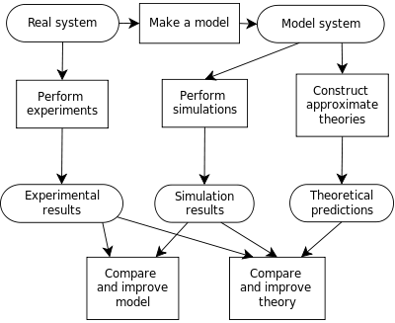
Notes:
This is an idea of a Computer Simulation where in it starts from an idea or desired output and makes a model while on the other hand, it makes experiments (maybe computations for the model to be used since we are talking about economics), the next stage is performing a simulation of the model which has details on why that model is made and what it is for and how it should work, while getting the experiment results. Having the desired results from the model simulation that’s being experimented, the model shall be made and the more efficient or improvement the model becomes it evolves into a better one.
Since it is about production it’ll be about how people allocate scarce resources for production, distribution, and consumption, both individually and collectively.

Slide 12
Economic Modelling
In Economic modelling we are referring to a complex real world, where in we make a model from it and make it simpler and make assumptions of how things are being done economically in a way that we would have estimated computations that are not really that accurate but may be used to understand, predict, and have a guideline economic movement.
Essentially, all models are wrong, but some are useful
- George Box, 1987

Slide 13
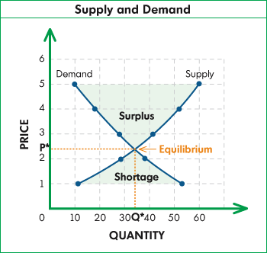
Example: In Economics, we have the Demand , Supply, the Price and the Quantity.
This General Equilibrium Model shows that the more an object is needed or demanded the price is affected specially because the supply started short.
Higher Price for Low Demand and Lower Price for High Demand. Same as the Supply
Notes:
Equilibrium is balance
Surplus is Excess
Shortage is insufficient

Slide 14
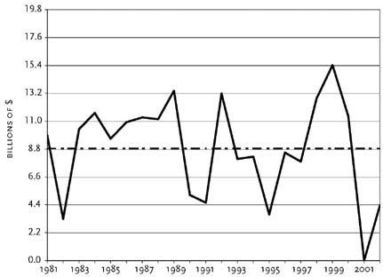
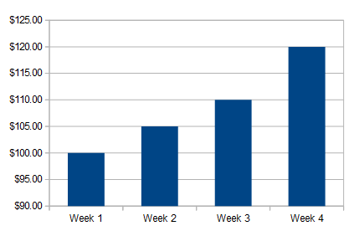
Computational Econometric Model
Statistical Model
Notes:
CEM – In the example it monitors the changes in the Money throughout the years
SM – Separately monitors how much income a week had

Slide 15
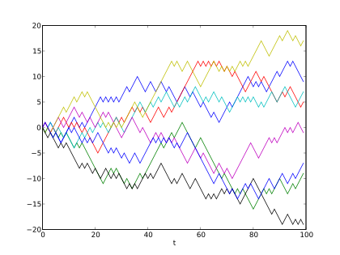
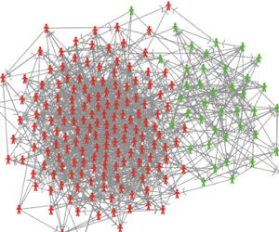
Computational Finance
Agent-Based Model
Notes:
CF – deals with problems of practical interest in finance ….. Monitors frequency of a thing or possibilities , it is like a competition, battle within speed to gain advantage to the opponent.
The images description: “Simulation of Brownian Motion sample paths is an important tool in calculating the price of financial instruments under the risk-neutral measure.”
ABM – agent-based computational (ABC) modelling makes it possible to study such processes, by modelling the behavior and interactions of the individuals that make up societies. As such, ABC modelling can help answering questions that are difficult to answer with other methods in the social science tool box. For example ABC modelling has already helped understanding the social dynamics that can underlie processes of residential segregation and the spread of infectious diseases.

Slide 16
VIDEO LINKS
Calculating a Consumer Price Index (CPI)
https://youtu.be/-IvsuVtzGko
Calculating Inflation using a CPI
https://youtu.be/iULCNJoMhos
Real GDP and the GDP Deflator
https://youtu.be/iNfNZ1mIGRE

Slide 17
THANKS!

